Slide 1
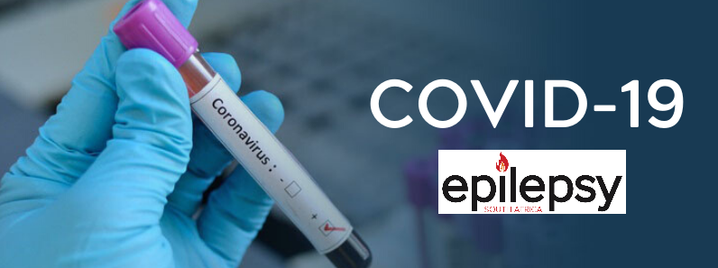

Slide 2
WEDNESDAY, 18 MAR 2020
There can hardly be a person on earth that has not yet heard of Coronavirus. At Epilepsy South Africa we’ve received several enquiries about the impact of the pandemic on persons with epilepsy.
We will thus interrupt our series of posts on human rights to provide information for persons with epilepsy about the pandemic.
This information is based on a factsheet created by Dr Simona Balestrini, the Muir Maxwell Research Fellow at the Epilepsy Society in the United Kingdom.

Slide 3
WEDNESDAY, 18 MAR 2020

Slide 4
THURSDAY, 19 MAR 2020
According to the World Health Organisation (WHO) Coronaviruses (CoV) are a large family of viruses that cause illness ranging from the common cold to more severe diseases such as Middle East Respiratory Syndrome (MERS-CoV) and Severe Acute Respiratory Syndrome (SARS-CoV).
Coronaviruses are zoonotic, meaning they are transmitted between animals and people. Detailed investigations found that SARS-CoV was transmitted from civet cats to humans and MERS-CoV from dromedary camels to humans. Several known coronaviruses are circulating in animals that have not yet infected humans.
COVID-19 is a new strain that was discovered in 2019 and has not been previously identified in humans.
Common signs of infection include respiratory symptoms, fever, cough, shortness of breath and breathing difficulties. In more severe cases, infection can cause pneumonia, severe acute respiratory syndrome, kidney failure and even death.
Standard recommendations to prevent infection spread include regular hand washing, covering mouth and nose when coughing and sneezing, thoroughly cooking meat and eggs. Avoid close contact with anyone showing symptoms of respiratory illness such as coughing and sneezing.

Slide 5
THURSDAY, 19 MAR 2020

Slide 6
FRIDAY, 20 MAR 2020
Do persons with epilepsy have a higher risk to get the coronavirus?
There is no evidence of increased risk of coronavirus infection in people with epilepsy compared to the general population. The risk is increased in people with weakened immune systems, older people and those with long-term conditions like diabetes, cancer and chronic lung disease.

Slide 7
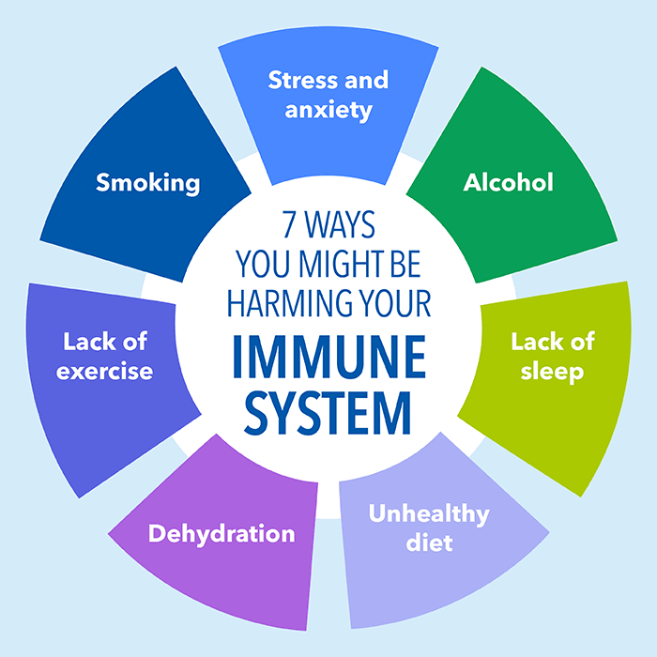
FRIDAY, 20 MAR 2020

Slide 8
SATURDAY, 21 MAR 2020
Do people with epilepsy have a weakened immune system?
There is no evidence that people with epilepsy have a weakened immune system. They should thus not be considered ‘immunocompromised’ or to have an ‘immune deficiency’.
Obviously, there are individual differences. For example, some people with epilepsy might have a weakened immune system due to other health conditions they may have and associated immunosuppressive treatment.

Slide 9
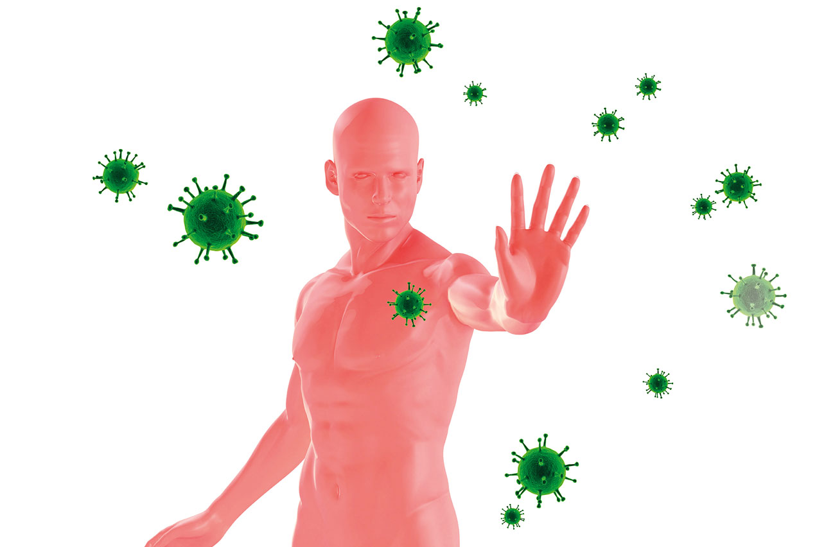
SATURDAY, 21 MAR 2020

Slide 10
SUNDAY, 22 MAR 2020
Does treatment with antiepileptic medications increase the risk of coronavirus infection?
There is no evidence of increased risk of coronavirus infection in people taking antiepileptic medications. Therefore, it is important to keep taking your epilepsy medicine as usual throughout any illness, including the current COVID-19 pandemic.

Slide 11
SUNDAY, 22 MAR 2020

Slide 12
MONDAY, 23 MAR 2020 (a)
What should I do to avoid the infection?
There are a number of measures that might help in reducing the risk of infection:
1. Avoid close contact with people who are unwell, especially if they have flu symptoms.
2. Wash your hands with soap and water or use hand sanitizer often, especially after using public transport and at any time before eating.
3. Cover your mouth and nose when coughing or sneezing with a tissue or a sleeve.
4. Try to avoid touching your eyes, nose or mouth if your hands are unclean.
5. Try to keep healthy by following a nutritious diet and taking gentle exercise.
6. Keep your home well ventilated by keeping the window open.

Slide 13
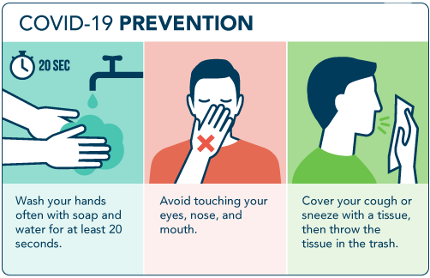
MONDAY, 23 MAR 2020 (a)

Slide 14
TUESDAY, 24 MAR 2020 (a)
What should I do if I have symptoms?
Call the COVID-19 hotline established by the Department of Health: 0800 029 999.
Stay at home for seven days if you have either a high temperature or a new persistent cough and you live alone. If you live with others and you or one of them have symptoms the whole household must stay at home and not leave the house for 14 days. This will help protect others in the community while people are infectious.
Most cold medicines that you might consider for symptom relief (typically paracetamol to control fever or muscle aches) are fine. But take advice before using products containing diphenhydramine (such as Benadryl). Check the label before purchasing any products and discuss interaction with your epilepsy medication.

Slide 15
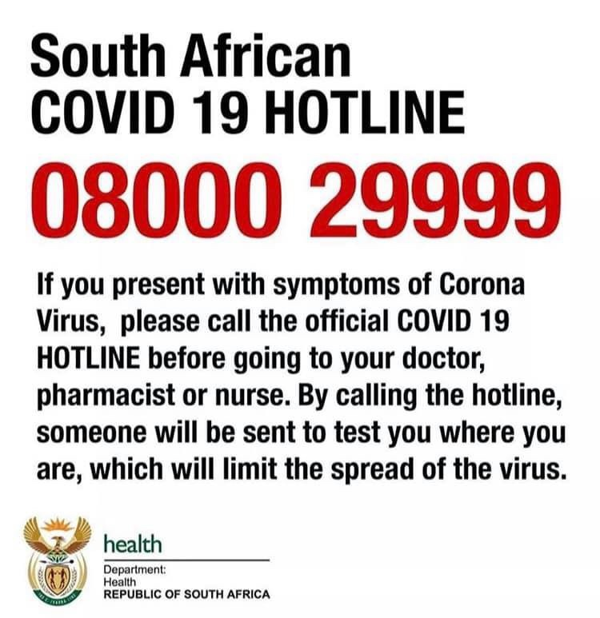
TUESDAY, 24 MAR 2020 (a)

Slide 16
WEDNESDAY, 25 MAR 2020 (a)
Will people with epilepsy be more severely affected by coronavirus?
For most people, coronavirus causes mild symptoms and they recover quickly after a few days. Currently there is no information to say that people with epilepsy are more severely affected than people without health conditions.

Slide 17
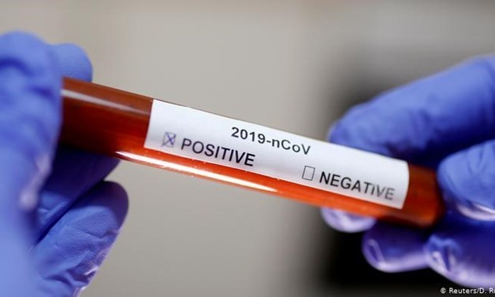
WEDNESDAY, 25 MAR 2020 (a)

Slide 18
THURSDAY, 26 MAR 2020 (a)
If I get COVID-19 could it trigger a seizure?
There is no information about coronavirus triggering seizures in people with epilepsy. However, infections, fever (particularly in children), sleep deprivation and in general being unwell can trigger seizures in some people with epilepsy.

Slide 19
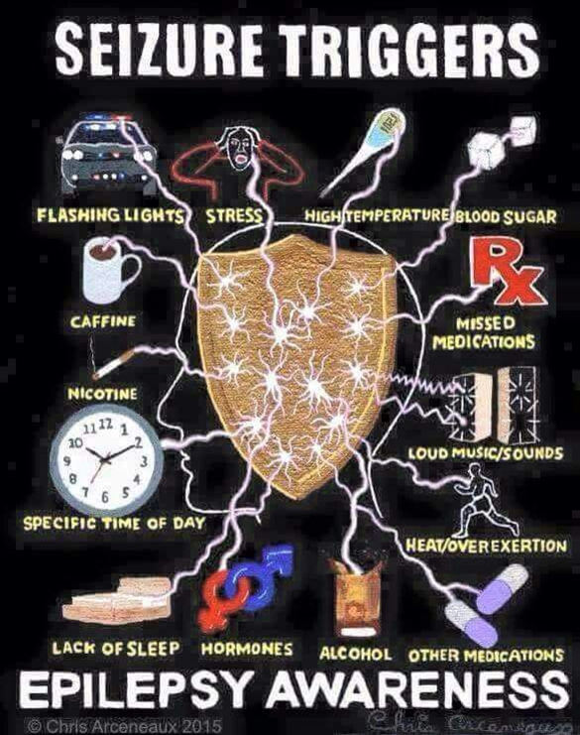
THURSDAY, 26 MAR 2020 (a)

Slide 20
FRIDAY, 27 MAR 2020
If I get COVID-19 do I need any specific treatment?
Many of your flu symptoms can be reduced with over the counter medications. The doctors involved in treating you might recommend antivirals, antibiotics or other specific treatment. Occasionally these may interact with your anti-epileptics, reducing their effectiveness or causing side effects. Always tell doctors treating you that you are taking anti-epileptic medications and ensure you know the dose and type of tablets you use.

Slide 21
FRIDAY, 27 MAR 2020

Slide 22
SATURDAY, 28 MAR 2020
Will the situation with coronavirus lead to shortages of my epilepsy medicine?
The South African Government and pharmaceutical companies are working to minimise any impact of coronavirus on drug supplies.
While there may be temporary disruptions to the supply chain do not try to stockpile your medication in case you have to self-isolate. This could cause shortages of medications and put others at risk of a seizure. It is best to carry on as normal.
Discuss your concerns about the supply of medication with your doctor soonest and follow his/her advice.

Slide 23
SATURDAY, 28 MAR 2020

Slide 24
SUNDAY, 29 MAR 2020
If I have to self-isolate how will I get my medicines?
The Department of Health in South Africa is currently advising people who may have been exposed to coronavirus to self-isolate. Just in case you need to do this you may wish to think now about how you would get your medicines. This could be getting a friend or family member to collect your prescriptions for you or making arrangements for your pharmacy to deliver your medicines to your home. You may wish to check with them now if they offer this service and how to sign up to it. Most prescriptions are now signed, sent and processed electronically.
Take your prescription to your pharmacy in plenty of time - up to seven days before you need your medication. This will allow your pharmacist to call other pharmacies or suppliers if there are any delays in getting your medication. Ordering your prescription in good time will also enable you to visit another pharmacy if your own pharmacy is temporarily closed due to the coronavirus.
Self-isolation is seldom longer than 14 days. Simply ensure that you have a supply of medication for this period.

Slide 25
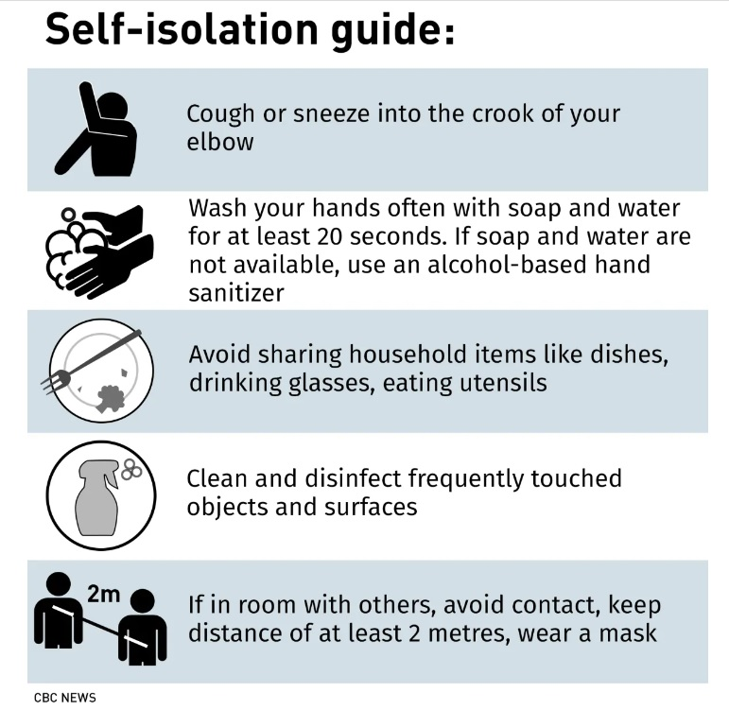
SUNDAY, 29 MAR 2020

